Slide 1

A Year in Review
Assessing Our Performance and Charting Our Course Forward

Slide 2
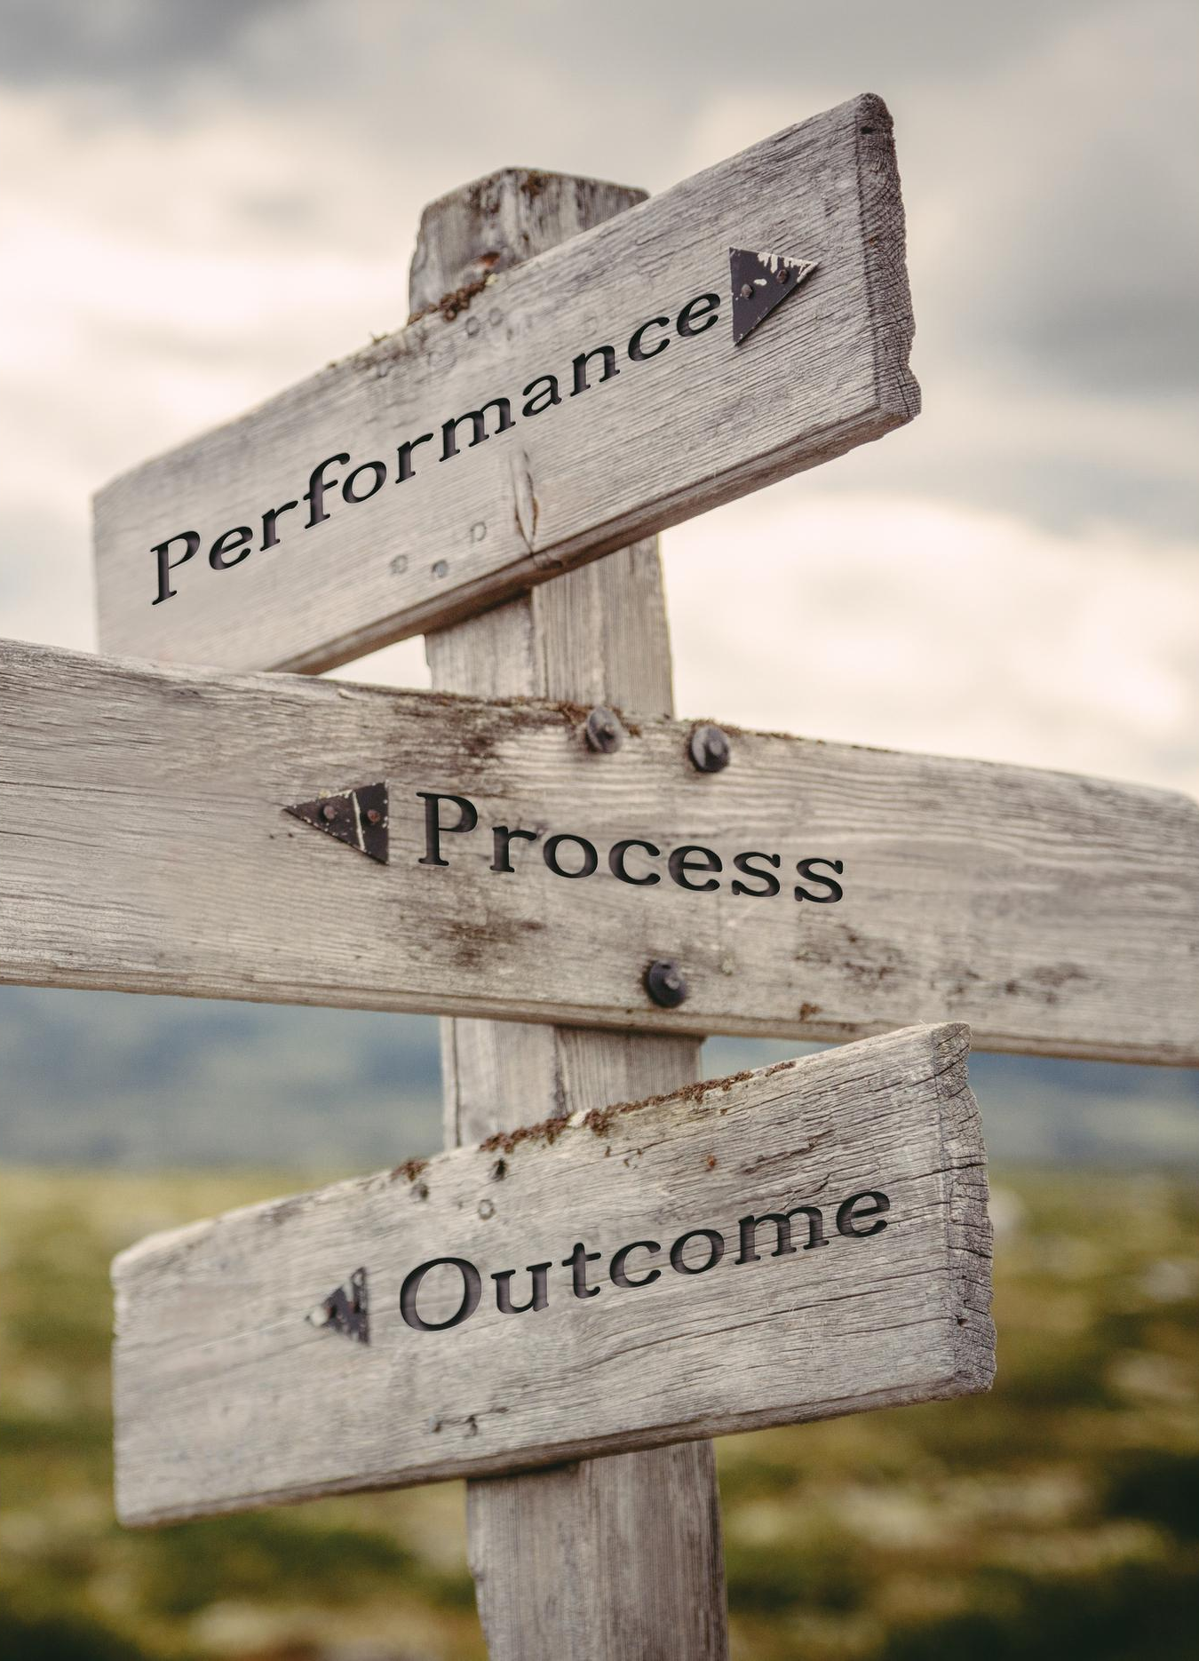
Executive Summary of Brand Annual Performance Review
Brand saw growth across several key metrics last year
Customer satisfaction dipped slightly in Q4 but remains high overall
Focus marketing efforts on new product lines for next year

Slide 3

Summary of Brand Performance for the Year
Total sales revenue for the year was $5 million
Our market share increased by 3% over last year
Customer satisfaction scores were at an all-time high according to our surveys
The new product launched in Q3 exceeded all sales targets

Slide 4


Challenges Faced by the Brand Last Year
Revenues dropped significantly year-over-year
1
New competitors entered the market with lower prices
2
A few major clients switched to other brands
3
Expenses grew faster than expected due to inflation
4

Slide 5

Next Steps for the Brand
Market Research
Brand Strategy
Creative Development
Launch Plan
Analyze competitor brands and customer needs
Develop messaging, personality, and positioning
Design logo, colors, and visual identity system
Roll out to target audiences and measure effectiveness

